Slide 1
Software Engineering
Chapter 9
Software Implementation from UML
Learning Outcomes
Know how to translate the components of a class diagram into Java
Text
Bruegge & Dutoit Chapter 10, Priestley Chapter 7
Notes:
Things you should look up:
Pressman - chapter’s 1 & 2

Slide 2
Mapping the model to code
Forward engineering
Refactoring
Model
transformation
Reverse engineering
Model space
Source code space
Operations on the object model:
  Optimizations to address performance requirements
Implementation of class model components:
  Implementation of classes
  Implementation of associations
  Implementation of operation contracts
Realizing entity objects based on selected storage strategy
  Mapping the class model to a storage schema

Slide 3
Model Transformation
To simplify or optimise the original model
  E.g.add/ remove classes, methods, attributes
Example
LeagueOwner
Advertiser
Player
-email:Address
-email:Address
-email:Address
Access levels
Modifier | Class | Pack -age | Sub-class | World
public | Y | Y | Y | Y
protected | Y | Y | Y | N
no modifier | Y | Y | N | N
private | Y | N | N | N
+
#
-
User
#email:Address
LeagueOwner
Advertiser
Player

Slide 4
Refactoring example (Pull Up Field)
public class Player {
private String email;
//...
}
public class LeagueOwner {
private String eMail;
//...
}
public class Advertiser {
private String email_address;
//...
}
public class User {
protected String email;
}
public class Player extends User {
//...
}
public class LeagueOwner extends User {
//...
}
public class Advertiser extends User {
//...
}

Slide 5
Refactoring example (Pull Up constructor)
public class User {
protected String email;
}
public class Player extends User {
//...
}
public class LeagueOwner extends User {
//...
}
public class Advertiser extends User {
//...
}
public class User {
protected String email;
public User(String em){
this.email=em;
}
}
public class Player extends User {
public Player(String em){
super (em);
//...
}
}
public class LeagueOwner
// …etc

Slide 6
Implementation example
User
LeagueOwner
#email:String
-maxNumLeagues:int
+notify(msg:String)
public class User {
protected String email;
public String getEmail() {
return email;
}
public void setEmail(String value){
email = value;
}
public void notify(String msg) {
// ....
}
/* Other methods omitted */
}
public class LeagueOwner extends User {
private int maxNumLeagues;
public int getMaxNumLeagues() {
return maxNumLeagues;
}
public void setMaxNumLeagues(int value) {
maxNumLeagues = value;
}
/* Other methods omitted */
}

Slide 7
Optimisation of the model
Repeated association traversals
  Inefficient access paths may exist
    E.g. one object calls another which in turn calls another.
    It may be better to call the last object directly
    (i.e. add an association to the class diagram
    between the first class and the third)
“Many” associations
  Use qualified association to reduce “search time”
Remove classes without behaviour (next slide)
Check for possible inefficiencies (later)
Add data structures to cache expensive computation results (e.g. in a sports example, suppose statistics change only after a match is played – an object might be used to store the latest statistics).

Slide 8
Removing Classes without behaviour
Object design model before transformation
Person
SocialSecurity
number:String
Object design model after transformation
Person
SSN:String

Slide 9
More Detail: Class Diagram to Implementation
A class diagram shows classes, attributes, methods
and associations in an application
Generally it will not contain low-level detail
  e.g. how to embed an application in a web page
  or display graphics in a window
Application frameworks make available this low-level functionality
  e.g. through inheritance from applet and canvas classes
For instance, a diagram editor application will require code to
  manage the interaction of the application with the environment
  - it may, for example, be running as an applet in a browser
  detect user input/output
  provide graphics functions
Application frameworks can be implemented for different target environments
  E.g. An applet framework, that enables a diagram editor
  to be run in a browser and draw on a canvas

Slide 10
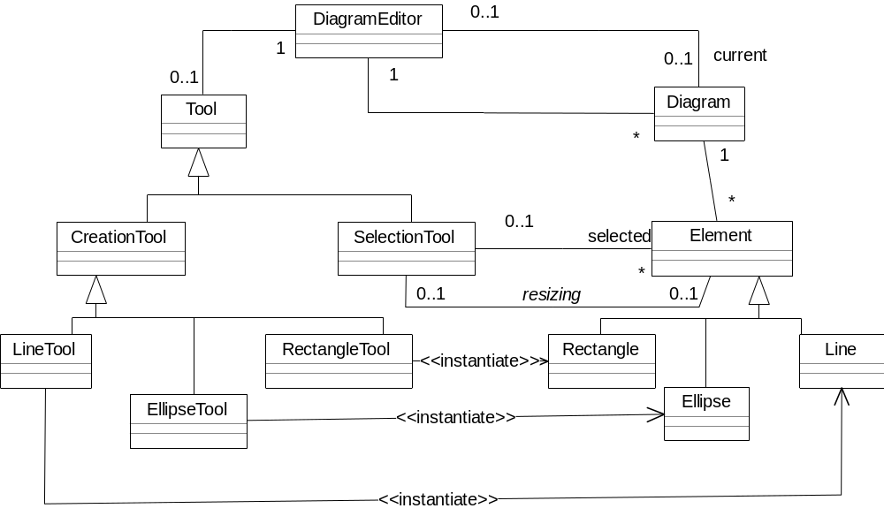
Applet Framework
Assume we already have a Diagram Editor
We will use a Diagram Editor Applet to call this
DiagramEditorApplet
1
1

Slide 11
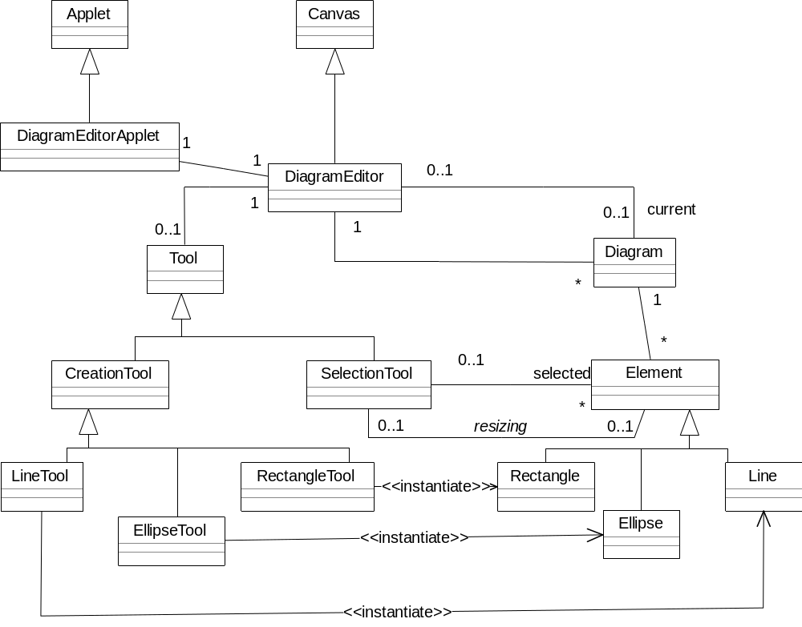
Applet Framework
DiagramEditorApplet inherits from Applet and creates and uses an instance of DiagramEditor: now DiagramEditorApplet can give access to the functionality of the DiagramEditor, while inheriting Applet’s interface to the environment (which might be a browser or an applet viewer). Meanwhile DiagramEditor inherits from Canvas, which can be painted, and which can trap input user events.
Java API (Application Programming Interface) code

Slide 12
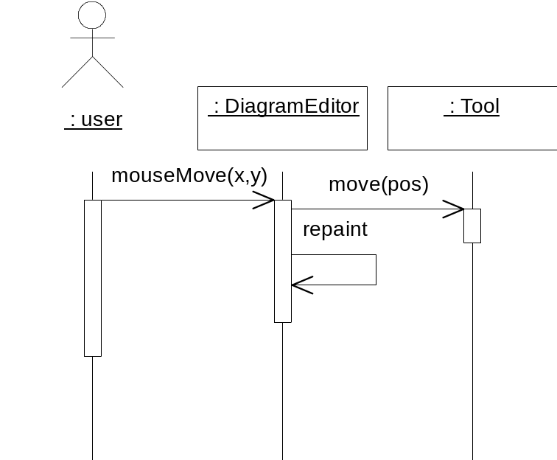
User input/output
Sequence diagrams are good for representing input and output
  The DiagramEditor inherits a moveMouse method via the Canvas.
  If, however, the DiagramEditor class overrides this method, it can first call the appropriate tool object, whether for drawing or selecting, and then repaint the (updated) Canvas.

Slide 13
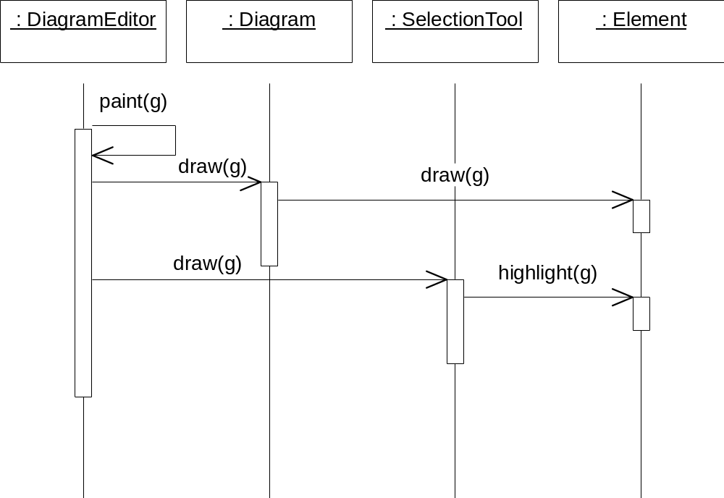
Redrawing the diagram
The paint method, which is called by repaint (previous slide) simply performs an update, which sends draw messages to:
  the diagram, which in turn draws
    Every element
  the current tool, which in turn
    highlights handles on any selected element (the case here).

Slide 14
Implementing Classes
UML Classes are implemented as Java classes (or C++…)
Attributes defined (normally) as private data
Methods/Operations defined (normally) as public methods
Tool
public abstract class Tool {
private Point current;
public abstract void delete();
public abstract void move(Point p);
public abstract void press();
public abstract void release();
}
current : Point
delete()
move(Point)
press()
release()

Slide 15
Inheritance
Generalisation / Specialisation implemented using inheritance
public abstract class Tool {
private Point current;
public abstract void delete();
public abstract void move(Point p);
public abstract void press();
public abstract void release();
}
Public class TextHighlightTool extends Tool{
private Point start;
public void move(Point p}{
...etc.
}
}
Tool
TextHighlightTool

Slide 16
Associations
Associations define links between objects
  e.g. one object knows about another
An association might imply that one object sends a message or receives a message from another object of a different class.
These messages may involve sending an object (or a reference to it) as a parameter (e.g. in a constructor)
In addition, some associations imply that one object is made up of another (even if an aggregation symbol has not been used!)

Slide 17
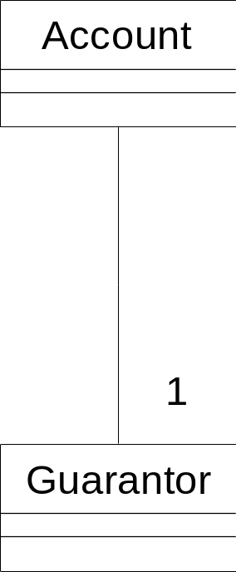
Mandatory (immutable) Associations
public class Account {
//data
private Guarantor theGuarantor;
//constructor
public Account(Guarantor g){
if (g == null) {
// ... throw NullLinkError
}
theGuarantor = g;
}
public Guarantor getGuarantor(){
return theGuarantor;
}
}

Slide 18
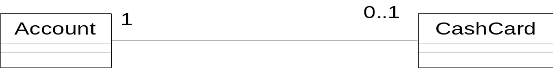
Optional Associations
public class Account {
private CashCard theCard;
public CashCard getCard() {
return theCard;
}
public void setCard(CashCard card) {
theCard = card;
}
public void removeCard() {
theCard=null;
}
}
set to null i.e can be optional

Slide 19
Associations with ‘many’ multiplicity
Need a data structure to hold multiple references (pointers):
e.g. vector, array, linked list…
Manager
import java.util.*;
public class Manager {
private LinkedList<Account> theAccounts;
public Manager() {
theAccounts = new LinkedList<Account>();
}
public void addAccount(Account acc){
theAccounts.add(acc);
}
public void removeAccount(int accIndex){
theAccounts.remove(accIndex);
}//...etc
}
*
*
Account

Slide 20
Bi-directional 1:1
public class CashCard {
private Account acc;
CashCard(Account a){
acc = a;
}
public Account getAccount(){
return acc;
}
}
When we create a CashCard we need to assign a reference to it for the Account it belongs to: it can belong to 1 account only
In this case allow Account to establish CashCard’s link to it.
public class Account{…
public void addCard(){
theCard=new CashCard(this);
}

Slide 21
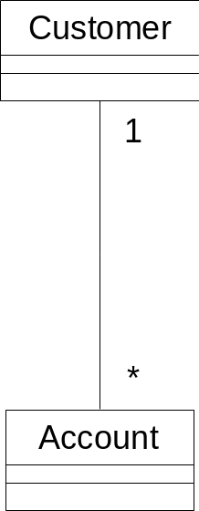
Bi-directional 1:*
Same problems/solutions as 1:1
Again, it is logical that the 1 side should be the one to maintain responsibility for creating
the link
Therefore Customer (as with Account previously) has the relevant code to create and associate itself with Accounts

Slide 22
Qualifiers / Qualified Associations
Account
Bank
accNo
0..1
0..1
Used to pick out the correct account instance
With the help of a hashtable we can retrieve account info using an account number
public class Bank {
private Hashtable<Integer,Account> theAccounts =
new Hashtable<Integer,Account>();
public void addAccount (Account a) {
theAccounts.put(a.getNumber(), a);
}
public void removeAccount(int accno) {
theAccounts.remove(accno);
}
public Account lookupAccount(int accno) {
return (Account) theAccounts.get(accno);
}
}

Slide 23
Software Engineering
Chapter 9
Software Implementation from UML
Learning Outcomes
Know how to translate the components of a class diagram into Java
Text
Bruegge & Dutoit Chapter 10, Priestley Chapter 7
Notes:
Things you should look up:
Pressman - chapter’s 1 & 2

